Slide 1
Image courtesy of Teri KO4WFP 2024

Slide 2
Getting Started in Parks on the Air®
Paul Butzi W7PFB
w7pfb@butzi.net
paul.butzi.org
August 9, 2024
Notes:
My name is Paul, my callsign is W7PFB, my email address is w7pfb@butzi.net
I’ve got a website and blog at paul.butzi.org which you can browse if you’re having trouble falling asleep at night.

Slide 3
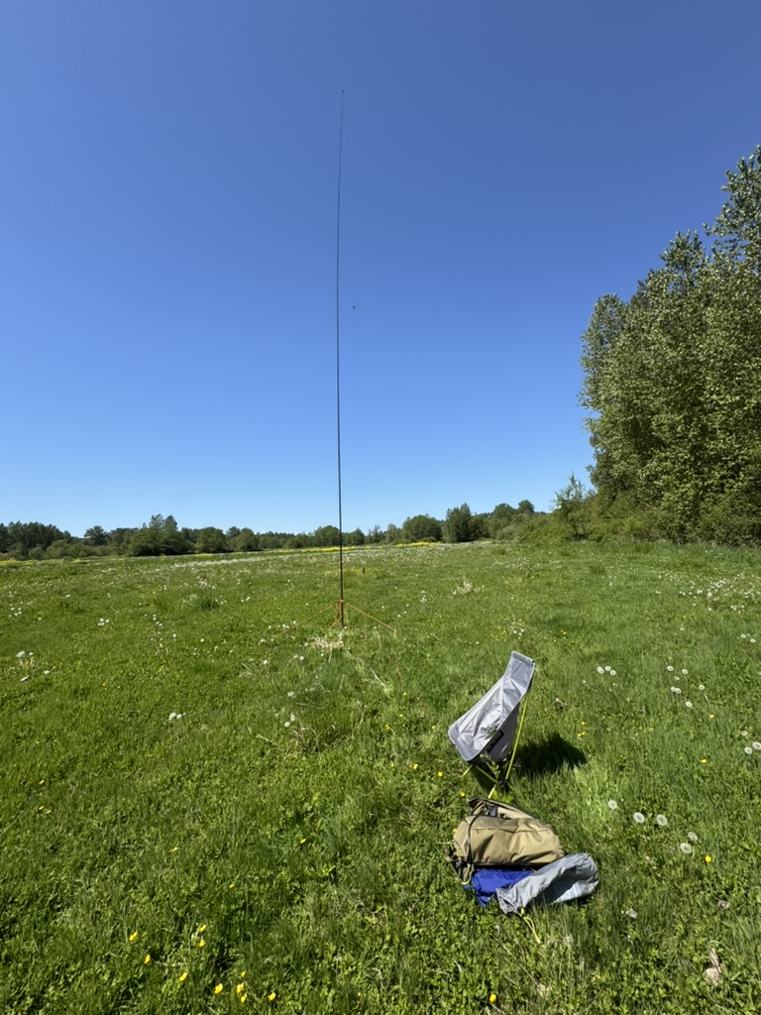
Alternate Titles
“POTA – DXPeditions on a Dollar a Day”
“POTA – Every Day Can Be Field Day”
“POTA – So much fun, it ought to be illegal”

Slide 4
I will present:
An overview of POTA history and how it works
Modest detail on how to participate
Some of my experiences and lessons learned
Pointers to some useful resources
Notes:
I’m not a super experienced POTA pro.
What I bring today is that I started POTA a bit more than a year ago and still remember the process I went through and the lessons I’ve learned.
My only qualification as an expert is that I remember getting started and I’ve done enough that I’ve learned a lot of lessons. I can remember the fun I had at every stage in my Parks on the Air journey.
I’m a fan of learning from mistakes. I prefer learning from other people’s mistakes but in a pinch I’ll learn from my own abundant supply. And I’m happy to share my mistakes so you can learn from them if you care to.

Slide 5
Whence cometh POTA?
ARRL National Parks on the Air
2016
Parks on the Air
(AKA POTA)
Notes:
ARRL had a National Parks on the Air program in 2016.
It was immensely popular and successful.
Because it was so successful and popular, a bunch of folks (list needed) formed Parks on the Air to continue the program and
Make it international
Include state parks, wildlife refuges, recreation areas, etc.

Slide 6
Whence cometh POTA?
ARRL National Parks on the Air
2016
Parks on the Air
(AKA POTA)
Notes:
Parks on the Air® is a registered service mark, owned by a 501(c)3 non-profit that administers the program and runs the website
Not a contest, just ‘radiosport’ of hams talking to hams
It’s incredibly successful, primarily because it’s incredibly fun.

Slide 7
How big is this POTA thing?
As of August 9, 2024:
Bigger than all the other “On the Air” programs (e.g. SOTA, Lighthouses on the Air, Worldwide Flora and Fauna in Amateur Radio, etc), combined.
Claimed more than 616,000 unique callsigns in database, with parks in more than 155 countries
18,000+ amateur radio operators activated at least one park
51,000 amateur radio operators had made at least one QSO with a park activation and registered.
29,440,452 QSOs
Notes:
As it currently stands, the Parks on the Air program is bigger than all the other "on the air" programs, Including SOTA, IOTA, Lighthouses on the Air, World Wildlife Flora and Fauna, combined.
More than 21300 participants have activated at least one park, and 51k participants have hunted at least one park. There are parks included in the program in more than 150 countries worldwide.
So - pretty big.

Slide 8
POTA growth
Notes:
Need an updated graphic

Slide 9
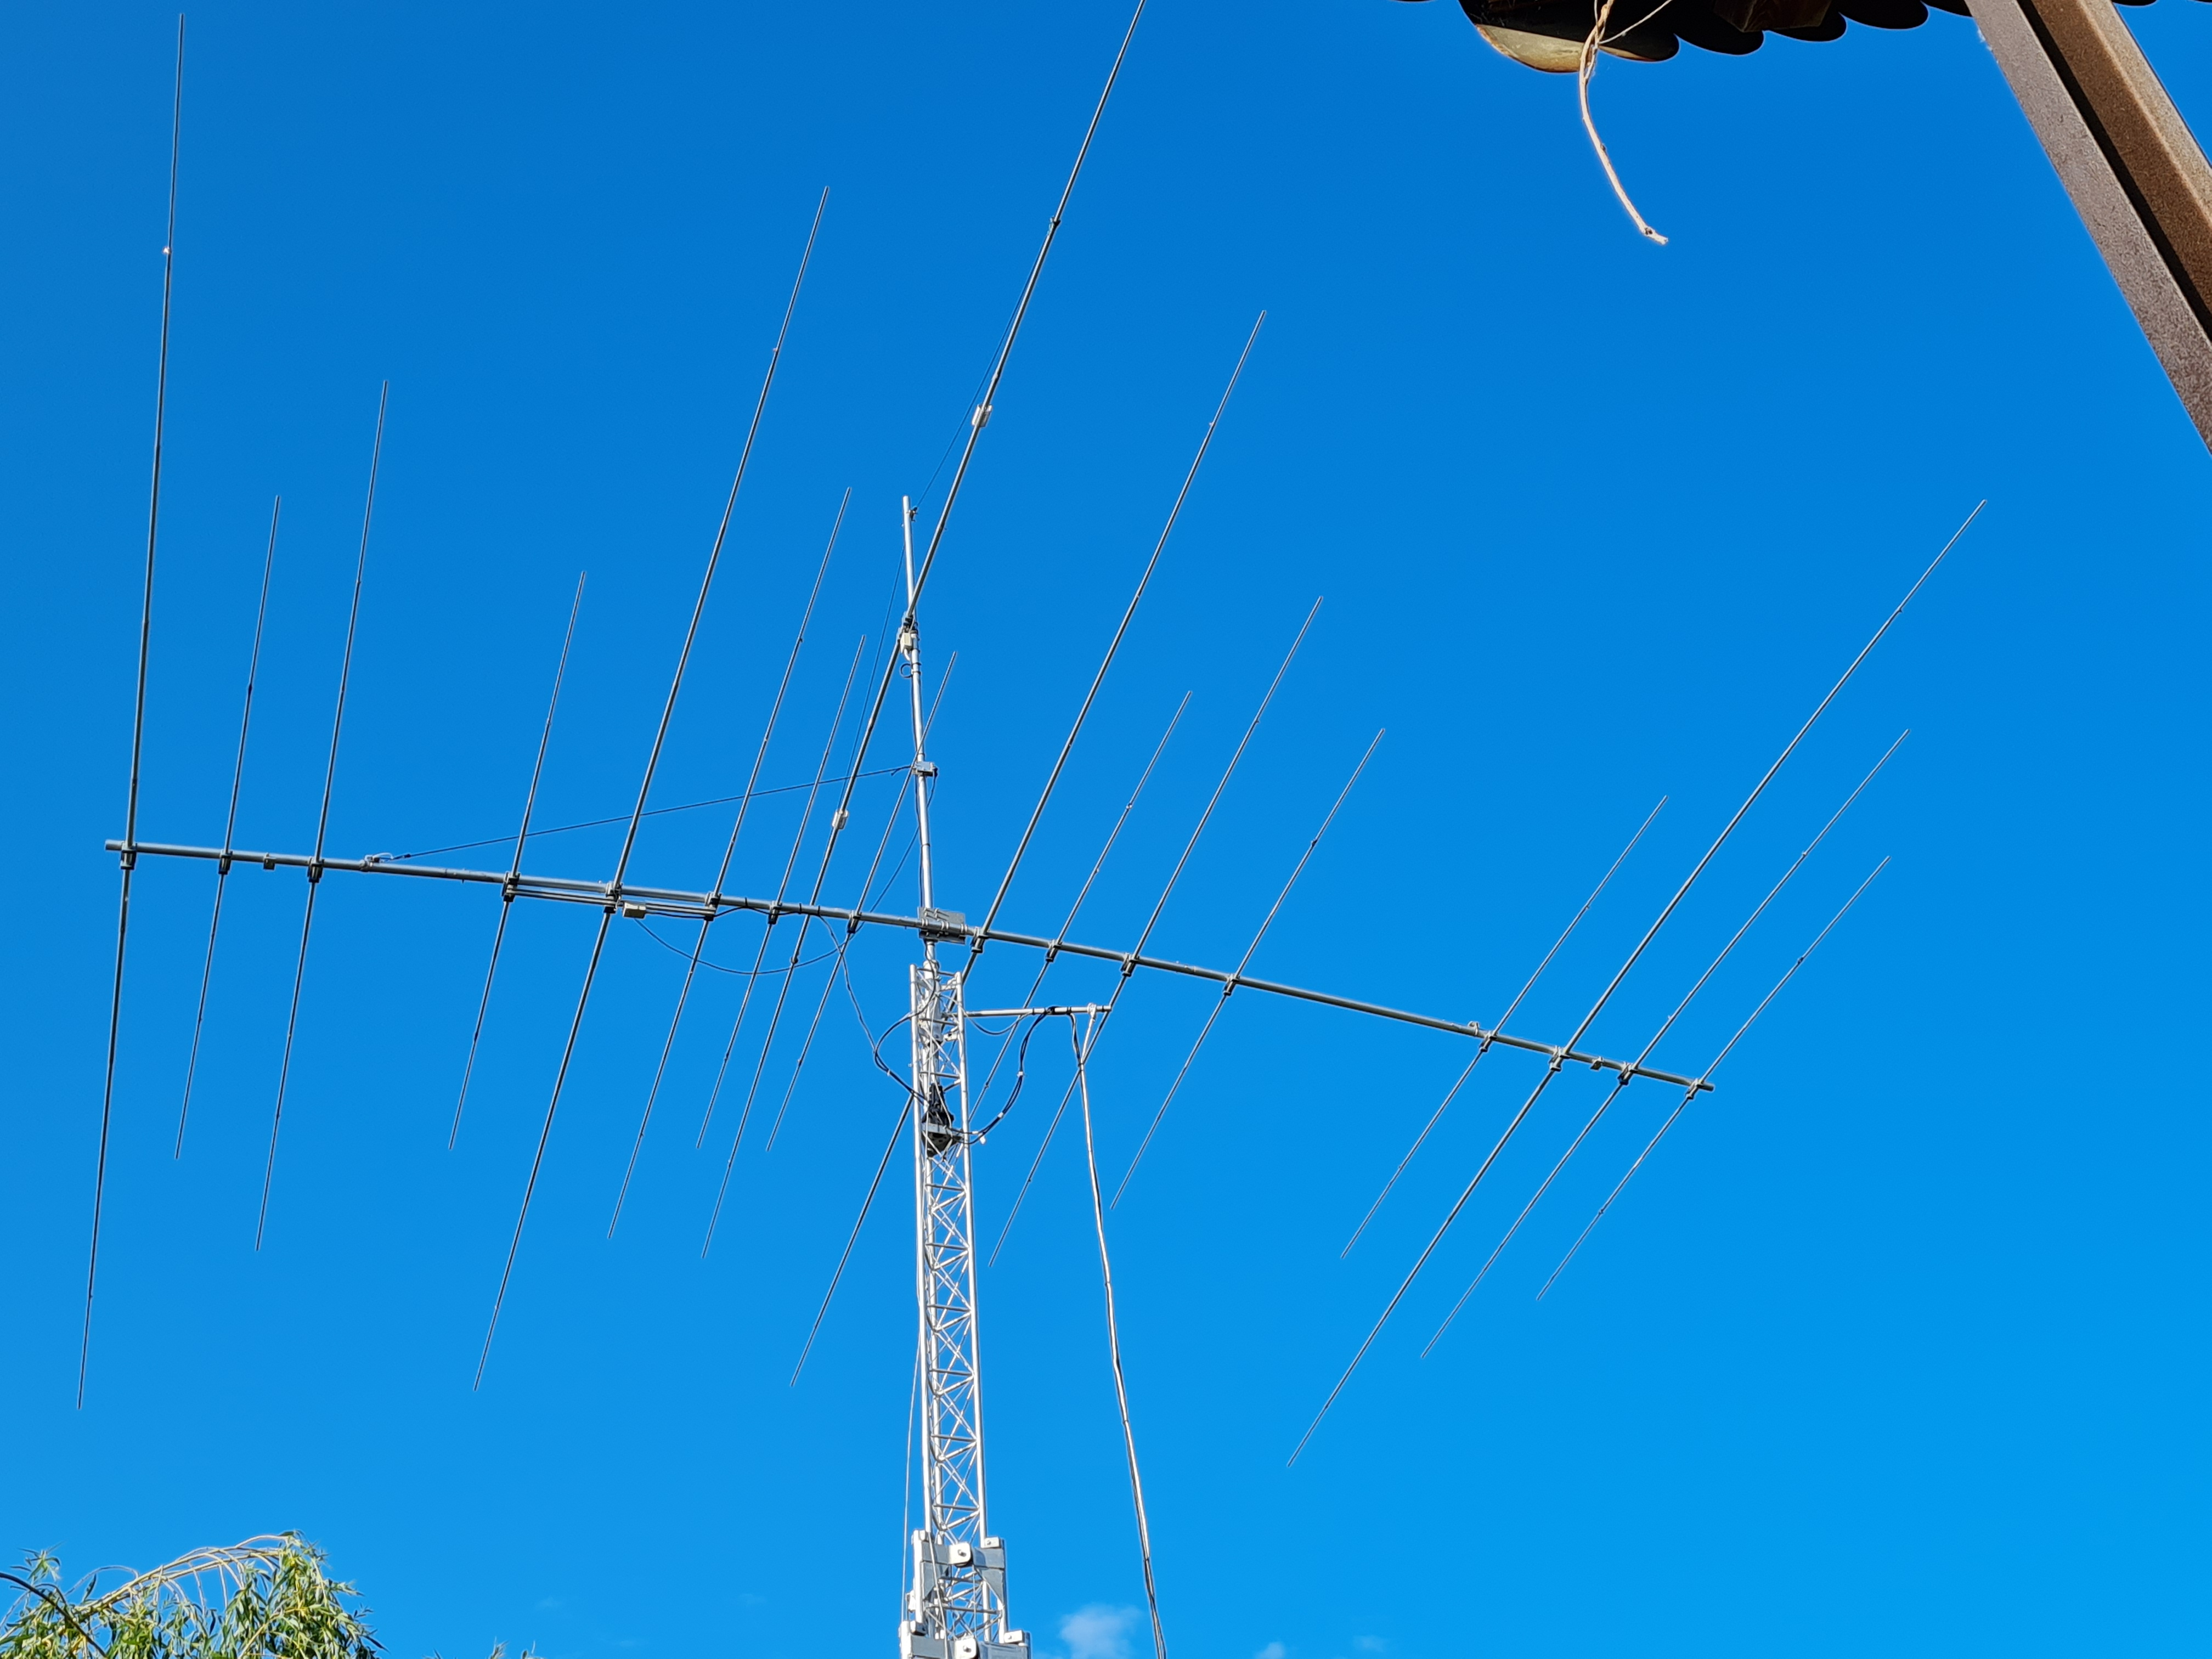
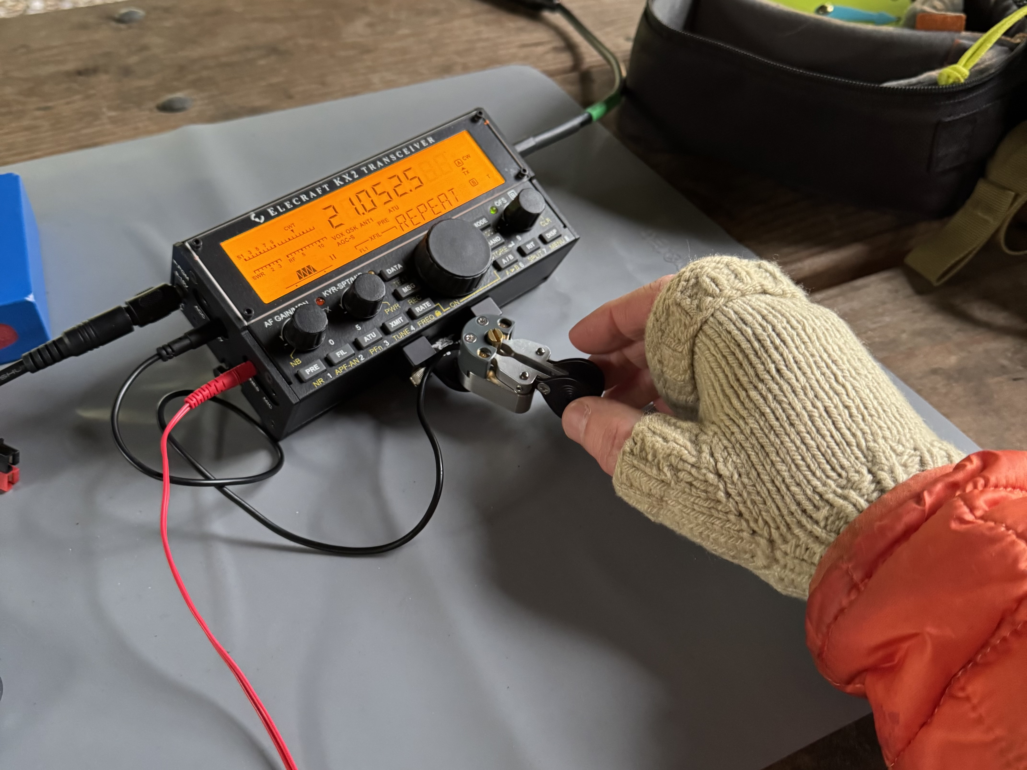
How it works
Notes:
A park is a national park, state park, including 'recreational areas', 'forests', monuments, &c.
County and city parks are not included.

Slide 10
How it works – the basics
A ‘park’ is a park, wildlife refuge, recreation area, etc. listed on the pota.app website
Two Roles: hunter, and activator
Activator sets up and operates from a ‘park’
Hunters seek contacts with activators
10 QSOs in one UTC day make for a ‘valid’ activation
Only activators need to upload logs
Notes:
There are two roles: hunter, and activator
A ham acting as a hunter can work from any place, *including a designated park*, but typically works from home QTH.
A ham acting as an activator must operate from inside a designated park.
All gear used must be within the park.
In the case of parks which are "trails" the activator and all his equipment must be within 100 feet of the trail.
Activators are spotted on the spotting page of the website at pota.app.
Hunters find activators on the air by looking at spotting page.
Hunters can *re-spot* activators and often include RST at their location as part of re-spot.
There is no required exchange, so any QSO counts. There’s no requirement that both participants in a QSO be registered at pota.app.
Activators *must* upload their ADIF formatted logs.
Hunters need not upload logs
Any mode is acceptable, but repeaters are not allowed except for satellites.
All bands are allowed.
Note that it's possible to be in more than one designated park at a time, and it's possible to activate multiple parks with one activation (aka twofers, threefers, &c)
In that case both activator and hunter get the credit for all the parks, so that a single QSO gets counted <n> times.

Slide 11
Parks
Current 319 registered in Washington State
Just under 12000 in US

Slide 12
Notes:
There are currently 319 ‘parks’ registered in WA, and just under 12000 in all of the US.
This map is from the pota.app website. You can also download lists of all the registered parks, by state or province or country.

Slide 13
POTA challenges - Hunter
Understanding the limits and performance of your home station
Maximizing how well your station can work weaker signals
Building overall fluency in operating
Working a simplex pileup
POTA awards – number of parks, WAS, etc.

Slide 14
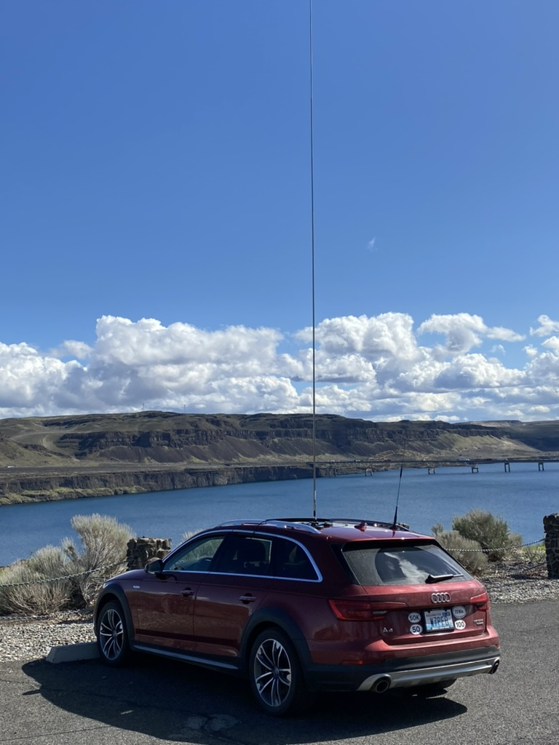
POTA challenges - Activator
how and what gear to pack for each activation adventure
How to be the DX including working pileups (in simplex!)
managing exchanges and logging tasks simultaneously
Understanding how propagation varies across time of day/seasons
Understanding characteristics and practical tradeoffs of antennas for portable operation
How to optimize portable operating environment even in difficult environments
How to get the best performance from a limited station
And also awards, awards, awards

Slide 15
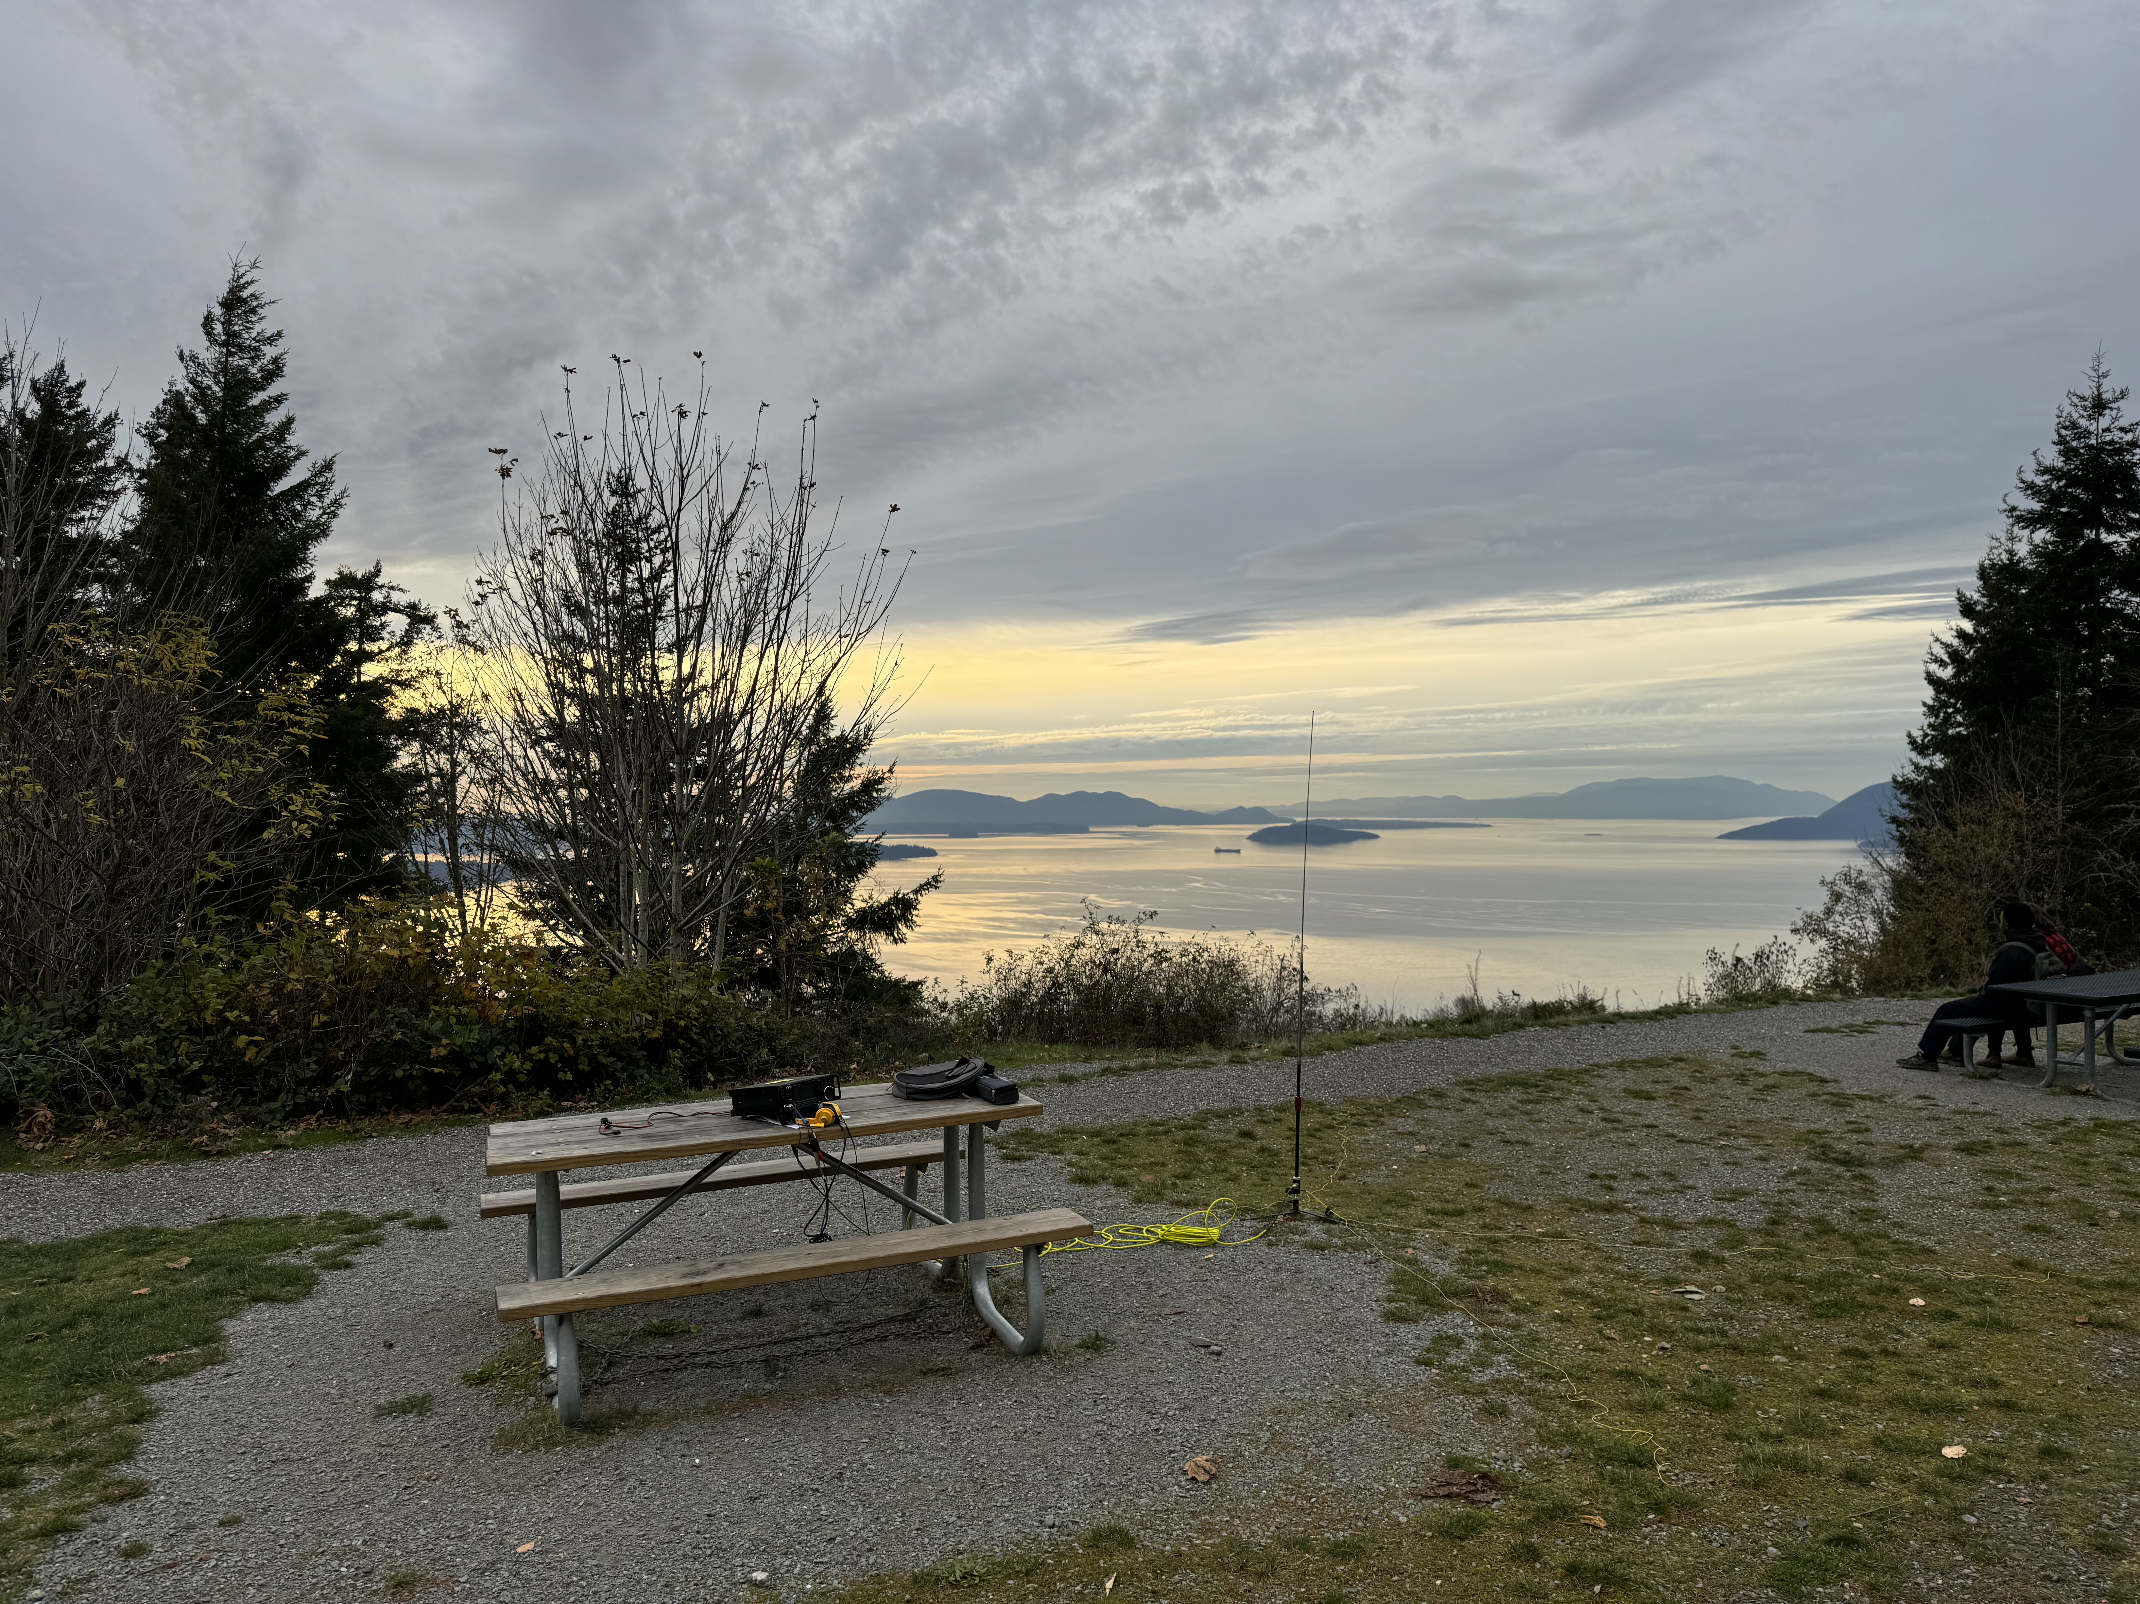
QSO style
Much more relaxed than typical DXPedition or contest QSO.
Signal reports are real, not just 599
SSB is often chatty, especially if not running a pileup
CW will include ‘friendlies’ like GM/GA, TU/TNX, names
CW speed generally between 15-25 wpm, faster operators generally match speed to slower op

Slide 16
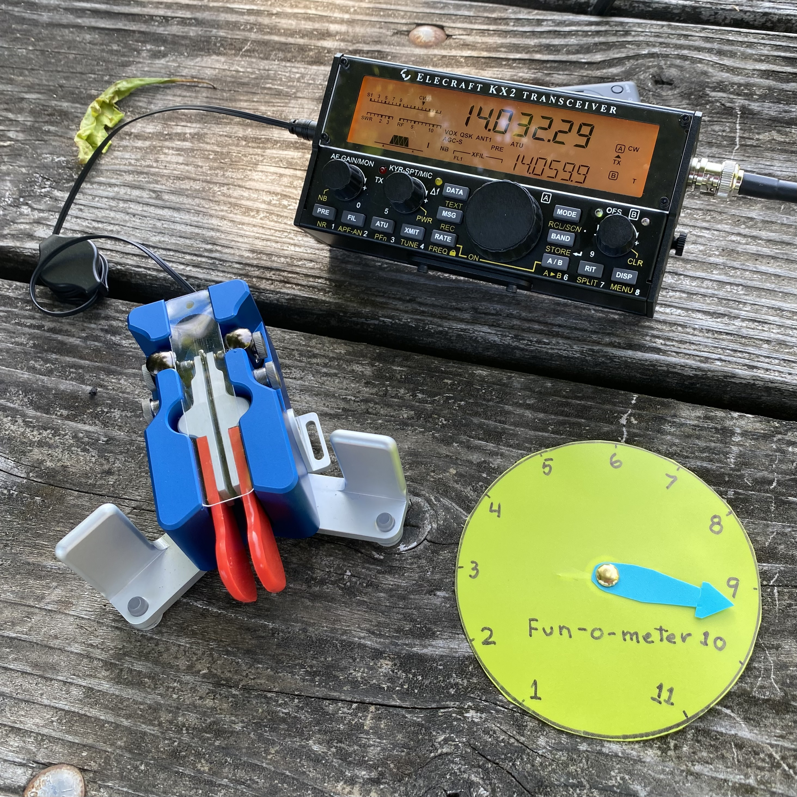
CW QSO example
CQ POTA DE WB0RLJ K
W7PFB
W7PFB GM PAUL UR 57N 57N NE NE BK
BK RR GA JIM UR 55N 55N WA WA TU ES GL BK
BK TU WA ES 73 DE WB0RLJ <DIT DIT>
Hunter: <DIT DIT>
Notes:
Here’s a hypothetical CW QSO between me (the hunter) and Jim Vaughn, WB0RLJ. Jim has done an activation of Chalco Hills State Rec Area every day for several years now. I’ve got more than 60 QSOs with Jim in my log.
His signal gets out really well across all of North America so he’s usually got a pileup. If it’s a huge pileup he might be more concise than this.

Slide 17
Hunting Basics
You can hunt from anywhere, including but not limited to a park
Activators never run split, always simplex
Activators are often running QRP, listen carefully
Listen to activator so you can match his tempo.
In POTA, signal reports tend to be real, not pro forma 599
In a pileup, to make it easier on the activator:
If CW, don’t zero beat
If CW, speed close to activator
Send callsign ONCE
Don’t tailend
Activations are spotted on web at https://pota.app
Notes:
In POTA-land, no one runs split.
Expect that activator’s signal might be quite weak, possibly requiring ESP to copy. Work them anyway. It’s good for you. Mr. Filter Control is your friend.
Some activators are running a pileup and will be working briskly. Others might be very conversational. Let the activator set the pace.
Getting real signal reports is very useful to the activator, who will use them to understand where his signal footprint is falling and how conditions are changing.
Remember that the activator is working simplex, not split, so pileups work differently because all callers are mushed together.
If everyone zero beats the activator, the activator calls CQ or QRZ and then just hears one continuous tone that’s impossible to copy.

Slide 18
Notes:
Here’s what the spotting page looks like.
You can limit the display to just one mode, here I limited it to SSB.
You can limit it to one ‘program’, which is one DXCC entity.
You can show or hide activations which have been spotted as QRT
You can hide stations you’ve hunted
You can sort the list by time of last spot, activator’s callsign, frequency, mode, reference number, park name, region, and callsign of spotter

Slide 19
Notes:
If you click on the little clock thing, you get the spotting history. You can turn off spots from the RBN if you want.
It can be handy to see RST in spots in various area if you’re wondering if it’s worth tuning to see if you can hear activation.
When you’re activating and have internet access it can be handy to look and see a summary of how you’re being spotted.

Slide 20
Notes:
After you complete a QSO with the activator, you can ‘respot’ him/her.
Note that the spotting page displays the time since the last spot.

Slide 21
Basics of Activating
You and all your gear must be entirely within the park.
Spotting yourself is not required
Any contact counts, not just people actively hunting.
Activators can also hunt other parks
All bands are fair game, including WARC bands and VHF/UHF
All modes allowed
No designated frequencies beyond convention for mode
No one operates split
YOU MUST UPLOAD YOUR ADIF FORMAT LOG
Notes:
You (and all your gear) must be entirely inside the designated park.
You **must upload your log**.
There's a whole spectrum of activation footprints and styles:
* set up quickly, do 10+ QSO's, close up shop. (can be as short at 15 minutes or so)
* Set up to go all day, activate for many hours.
* Set up at campsite, operate over several days.
* Do short activations of more than one park in a single day (roving)
Each style of activation has different challenges and different rewards.
You get to choose what you do.
Some activators run QRO, some run 100W, many operate QRP.
Some activators work from vehicles (stationary, or mobile), some work from picnic tables, some from benches, some from portable chairs &c.
Many SOTA references are in POTA parks and often activator will be working both POTA and SOTA hunters/chasers
Some activators use a single band, some will work many.
Some activators will use a single mode, some will work CW & SSB & digital, or throw in UHF/VHF FM.
Antennas - a wide variety, from things like Buddihex to quarter λ verticals to doublets, OCFD, inverted V dipoles, EFHW and EFRW. Some activators use telescoping masts, some use vehicle mounts, some throw a line into a tree.
*be aware of park regulations and rules*.
Examples: in national parks (and many other sites), no driving stakes to guy antenna mast.
In WA state wildlife refuges, no putting lines/antennas in trees.

Slide 22
Spotting
Got internet access? Spot using pota.app web page
Got APRS? Spot by sending message to APSPOT
Spot using HF radio by using SOTAMAT phone app
Spot using sat communicator like Garmin InReach to send message to SOTAMAT service
Using CW? Schedule activation on pota.app webpage, and RBN will pick up your CQ, forward to pota.app to spot you
Notes:
It’s possible to do an activation without getting spotted on the pota.app spotting page but it’s a lot harder.
You can spot yourself in a number of ways, including having a friend listen for you to go QRV and then spot you.
If you’re working CW, and you schedule the activation on pota.app, the RBN will forward spots to pota.app and you’ll be spotted.
Once you’ve been spotted on CW, the RBN will (usually) forward spots to pota.app and you’ll be respotted every time the RBN hears you, including if you QSY.

Slide 23
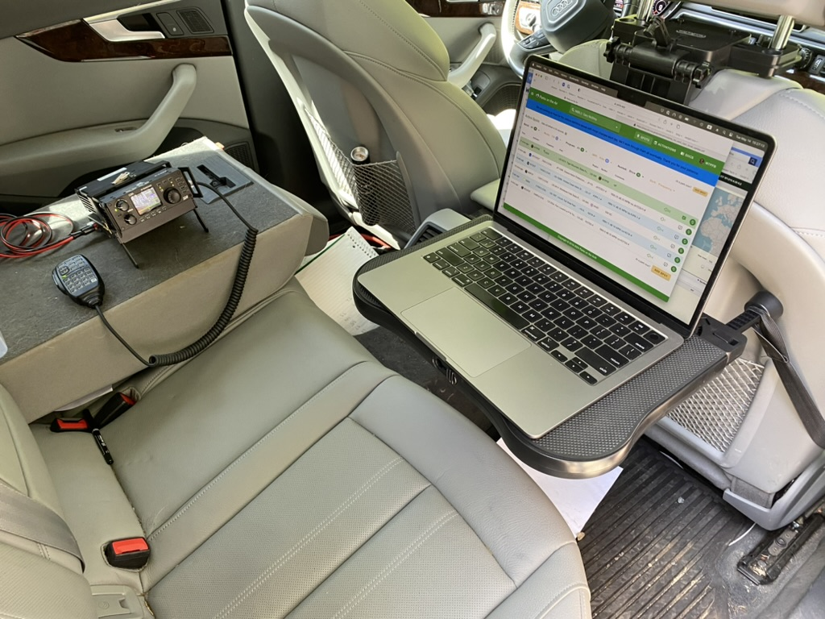
Work from inside car
Notes:
When I do activations from my car, the setup will be along these lines.
The radio here is a Xiegu G90.
* bought to leave in the car all the time
* 20W, easy to do digital
* audio is tiring, front end is wide open so RFI
Laptop will use my phone as a hotspot and laptop desk is attached to the front seat headrest and folds out of the way when not in use.
I’ve run very similar setups using a KX3/KXPA100 and Icom IC-7300.
This is great for short activations but the fixed position leaves you pretty stiff.

Slide 24
Back of truck
Notes:
I had Lake Sammamish State Park (US-3216) in my hamalerts list and was in Issaquah when I got a hit, I went to the park to find Darrian Davis KK7DIA set up and working.
He’s running an EFHW with a telescoping mast tied to a fence post out of sight, and an Icom IC-7300 powered by a Bioenno battery. He logs on paper.
You can see he has a roll of window screen to use as a counterpoise substitute for a vertical antenna.

Slide 25
Back of truck
This is Kelly K7MI doing an activation of Deception Pass State Park, photo courtesy of Kelly.
Notes:
This is

Slide 26
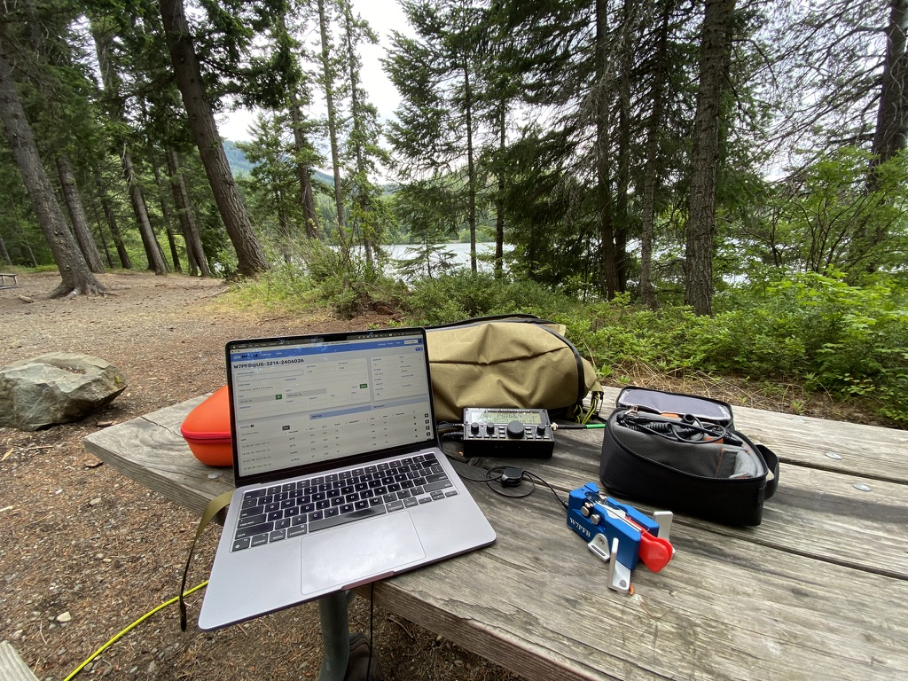
Work from Picnic Table right next to vehicle
Notes:
This is from my activation of Lake Easton State Park (US-3214).
Again, trusty laptop for logging, using my cellphone as a hotspot.
Radio is an Elecraft KX2. This was my first activation where I did a valid activation using CW, then did a few SSB contacts at the end.
Antenna here is a Chelegance MC-750 quarter λ vertical. I love it, it’s nearly as fast as the vertical on the car to get setup and then tear down. The brightly colored feedline is from ABR Industries.

Slide 27
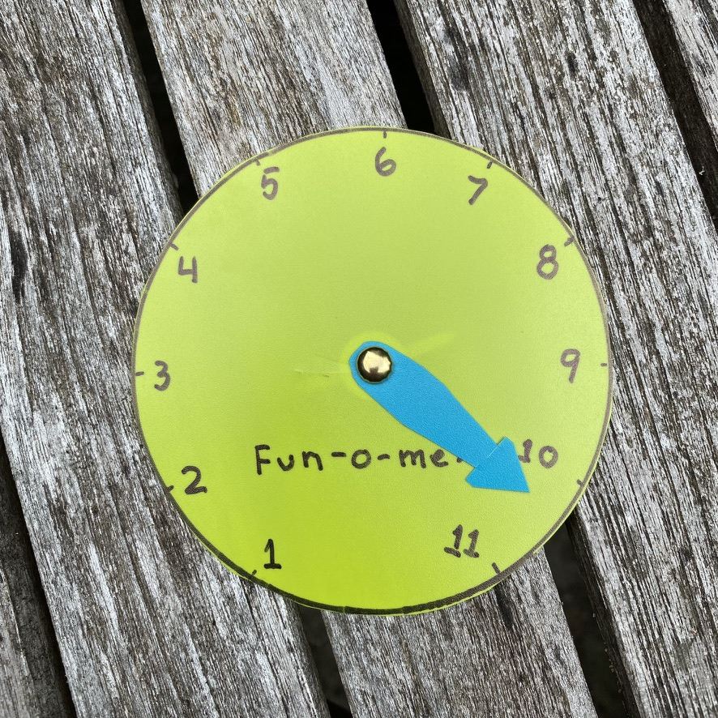
Work from Picnic Table

Slide 28
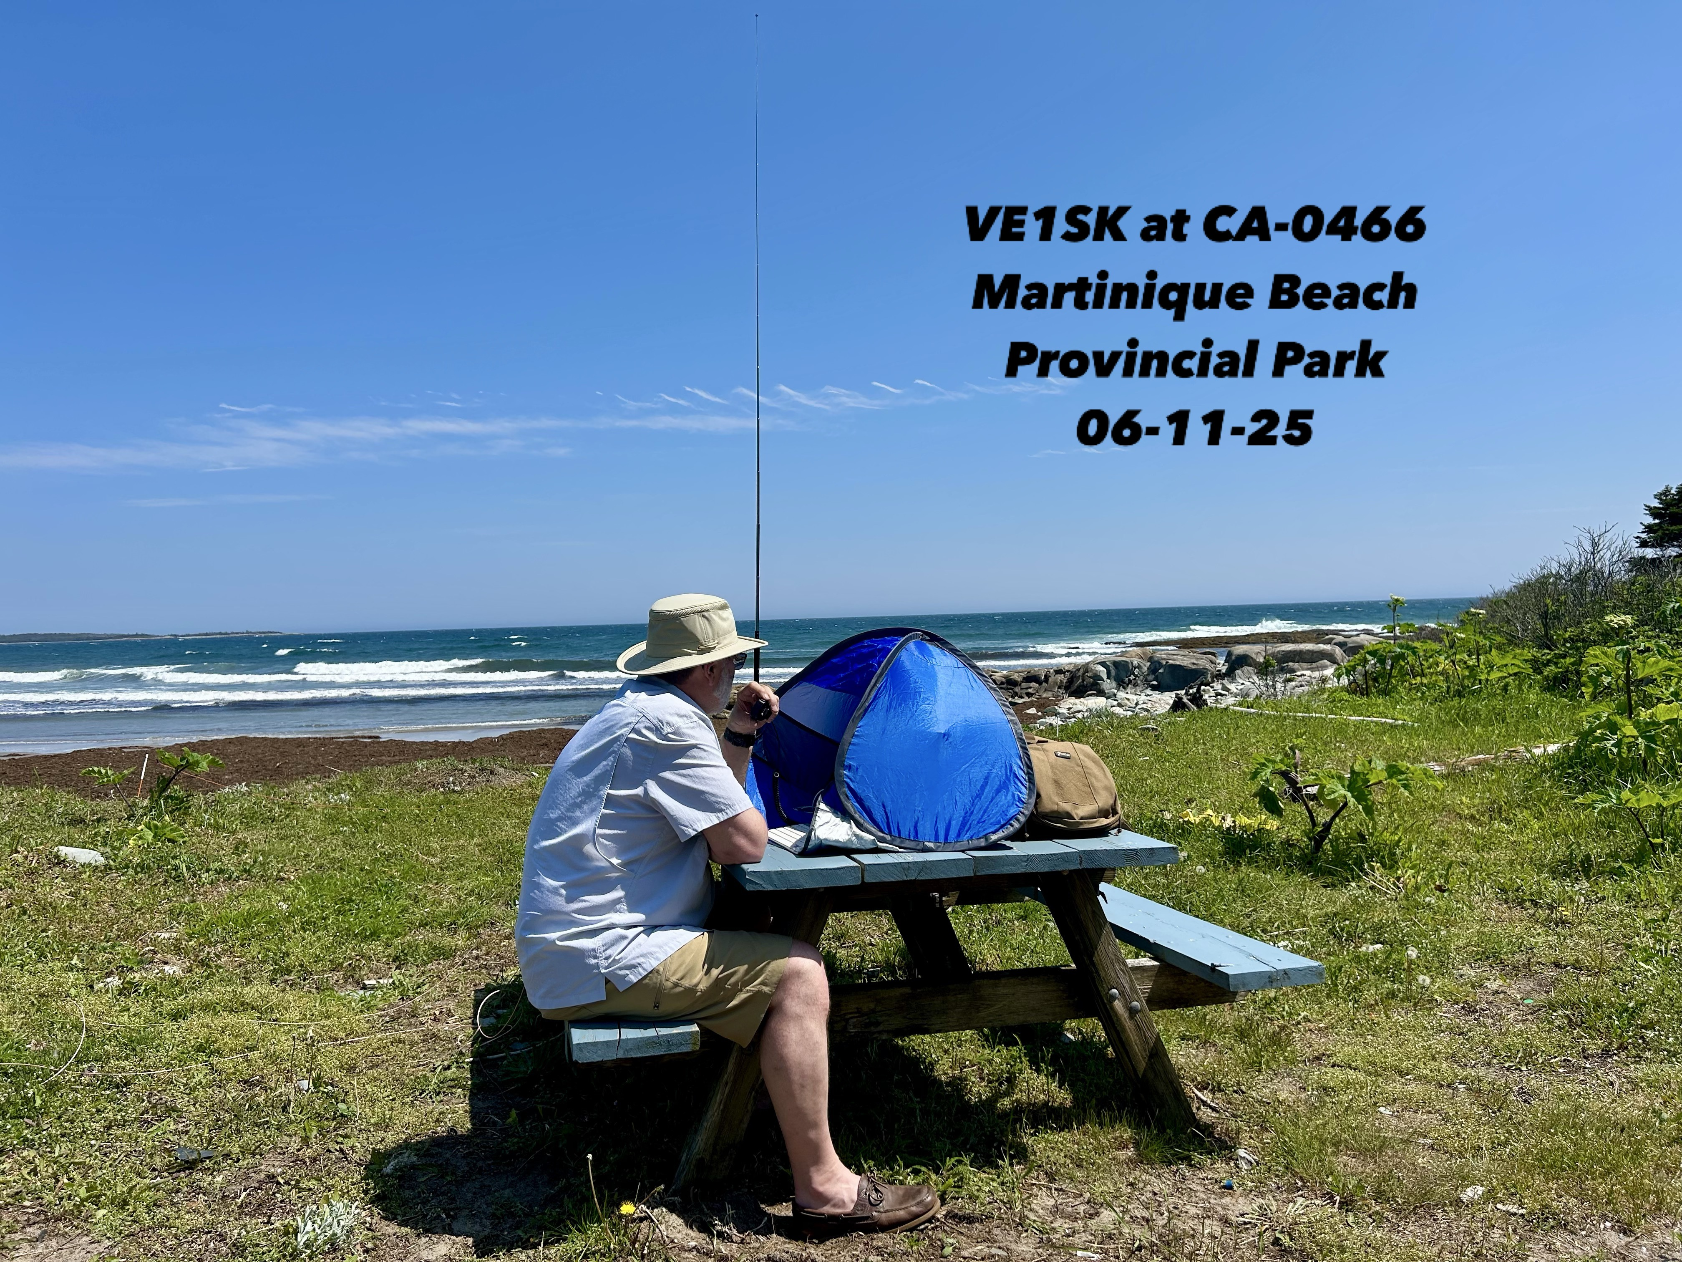
Picnic Table
Walk distance = vehicle to picnic table
Carry all your gear and what you need to be comfortable – maybe more than one trip
Some folks use wheeled carts, &c

Slide 29
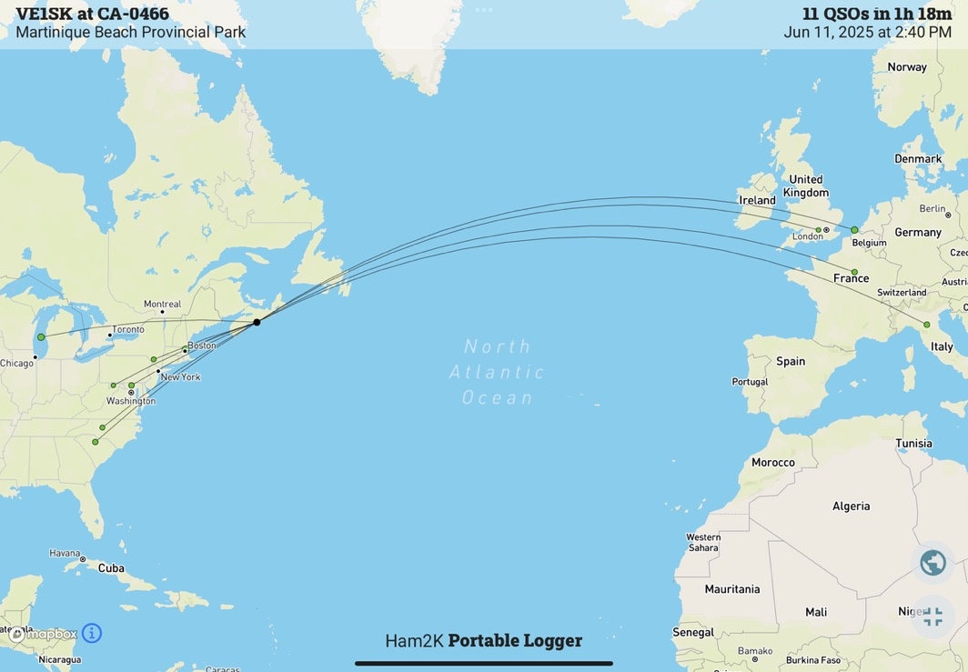

Slide 30
Walk in
Walk distance = 0 to ? Miles
Carry all your gear and what you need to be comfortable
Maximum emphasis on lightweight portable gear
Notes:
This is from my activation of US-12342 Stillwater Wildlife Area
Again, trusty laptop for logging, using my cellphone as a hotspot.
Radio is an Elecraft KX2. This was my first activation where I did a valid activation using CW, then did a few SSB contacts at the end.
Antenna here is a Chelegance MC-750 quarter λ vertical. I love it, it’s nearly as fast as the vertical on the car to get setup and then tear down. The brightly colored feedline is from ABR Industries.

Slide 31
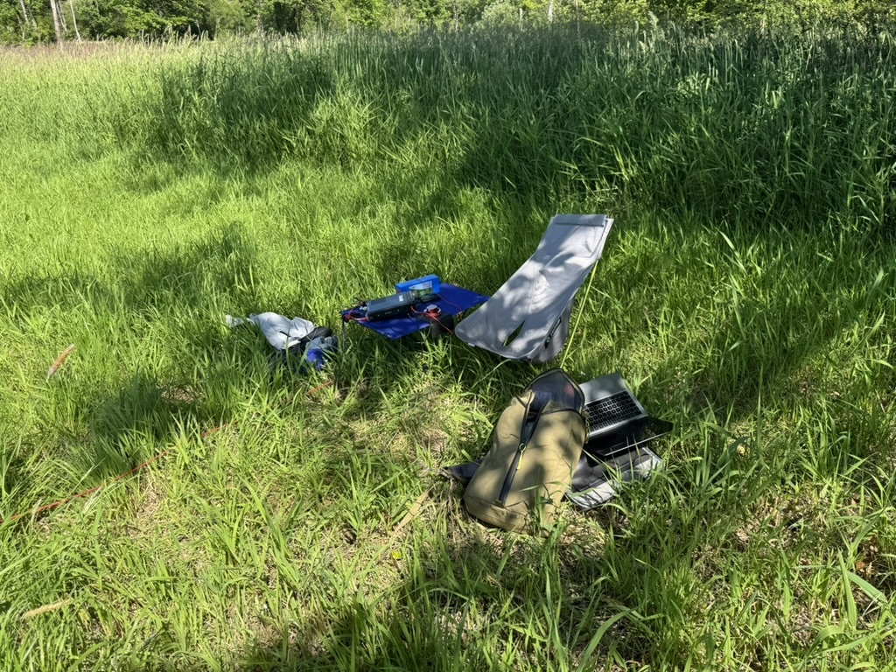
Walk in
Notes:
This is from my activation of US-12342 Stillwater Wildlife Area
Again, trusty laptop for logging, using my cellphone as a hotspot.
Radio is an Elecraft KX2. This was my first activation where I did a valid activation using CW, then did a few SSB contacts at the end.
Antenna here is a Chelegance MC-750 quarter λ vertical. I love it, it’s nearly as fast as the vertical on the car to get setup and then tear down. The brightly colored feedline is from ABR Industries.

Slide 32
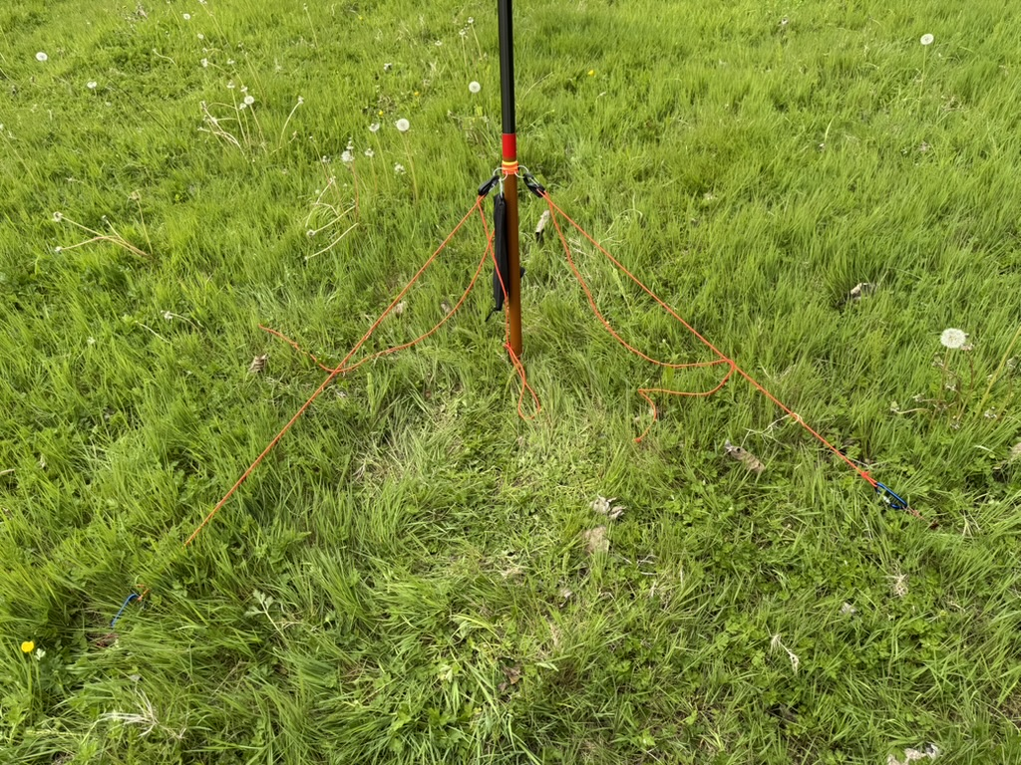
Even lighter walk in
Notes:
This is from my activation of US-12342 Stillwater Wildlife Area
Again, trusty laptop for logging, using my cellphone as a hotspot.
Radio is an Elecraft KX2. This was my first activation where I did a valid activation using CW, then did a few SSB contacts at the end.
Antenna here is a Chelegance MC-750 quarter λ vertical. I love it, it’s nearly as fast as the vertical on the car to get setup and then tear down. The brightly colored feedline is from ABR Industries.

Slide 33
My first activation
Much uncertainty, much planning of irrelevant detail
In the end, threw a HUGE pile of gear into car, drove to park, threw the switch
Took me ages to get antenna set up, radio set up, etc.
46 QSOs in 34 minutes once QRV
Hopelessly inept at logging at that pace.
Hopelessly inept at handling any sort of pileup
Took me two days to figure out how to upload log
Notes:
Oct 30, a Thursday evening.

Slide 34
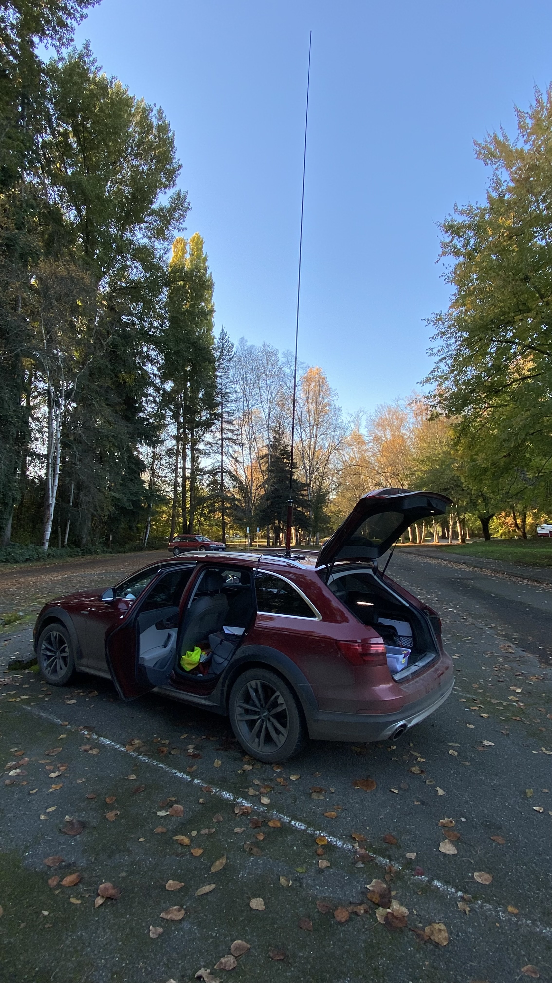

Slide 35
Things I learned
I got lucky with condx and band selection
Having suitable equipment at hand is key
Setup and teardown should be much more streamlined
Avoid complication that doesn’t bring needed capability
Operating skills needed improvement
Activating parks is incredibly fun
Notes:
So many encouraging contacts from hams who realized it was my first activation.

Slide 36
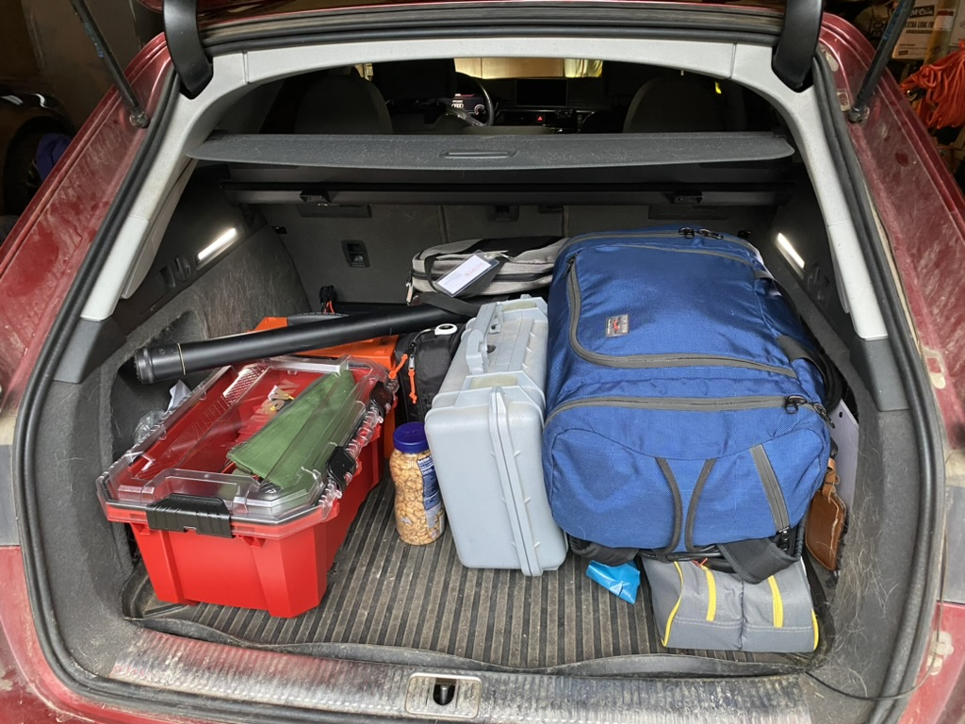
N3JCJ memorial rove
Original plan:
Drive to Boise, activate on the way
One day in Boise, activate during day and then attend show opening
Drive back to Carnation, activate along the way
As implemented
3/12 – 5 parks, 105 QSOs
3/13 – 1 park, 20 QSOs
3/14 – 3 parks, 96 QSOs
3/15 – 2 parks, 37 QSOs
Notes:
The plan: two days to Boise doing POTA along the way, one day in Boise doing POTA and attending opening, two days back to Carnation doing POTA along the way.
The big picture goal: After I'd spent a month dealing with my Dad's hospitalization, supporting my Mom, Dad's death and memorial, I was mentally and physically pretty much wrecked. Five days more or less alone, playing radio and getting some mental space and time to try to get my head screwed back on straight.

Slide 37
N3JCJ Memorial Rove Gear List
Used:
Icom IC-7300
17’ whip and magmount
Heil Pro7 Headset and hand switch
Laptop
30AH LiFePO4 battery
Headrest fold down table
RigExpert Stick 500 antenna analyzer
12v chargers for laptop and LiFePO4 batteries
Backup:
Elecraft KX3/KXPA100
31’ telescoping mast
Four different wire antennas
Chelegance MC-750 vertical antenna
Folding chair and table
50’ rg8x feedline
6AH LiFePO4
Spares and tools bag
Notes:
The plan:
* optimized operating position in car back seat with headrest fold down table.
* Main antenna: 17' Chameleon telescoping whip on triple magmount
* IC-7300 as main operating radio
* KX3/KXPA-100 taken as backup radio (never used)
* Mac laptop for logging (recharged while driving)
* Heil Pro 7 headset and hand PTT.
* Power from Bioenno 30AH battery (recharged while driving if needed)
I practiced setup/strikedown before hand a dozen times to get it fast and smooth. Time from parking car to QRV: less than 4 minutes
Time from QRT to moving: less than 5 minutes
Backup gear taken:
* EFHW 40/20/15 wire antenna and throw line/bag
* Chelegance MC-750 1/4λ vertical with tripod and spike
* Elecraft KX-3/KXPA-100 as backup/alternate radio

Slide 38
Rove Results
Things I learned:
Advance research is useful but don’t overdo it.
Bathroom break first
Don’t forget to enjoy the park
Site selection within the park
How to do fast setup and strike
SSB operating skills
How to make it fun for me, and fun for callers
Notes:
What actually happened:
* Day 1: 5 parks activated
* Day 2: 1 park activated, plan to activate 4 more scrapped to get around closure of I-80
* Day 3: 3 parks activated close to Boise
* Day 4: 2 parks activated, headed home.
the most useful pre-activation research is to look at a park map to assess options in advance, and aerial photograph to assess possible activation spots for things like power lines &c.
Bathroom break first
Don't forget to get out and enjoy each park.
Site selection:
Topography
Be courteous to other users of park
Cell service
Reasonable setup area
Practice setup and strike pays off
Activation time will vary with time of day, propagation, &c. Be flexible.
Make it fun for you and the hunters:
Make QSOs warm and fun.
Say thank you and mean it.
Keep track of the usual suspects and learn their names, pets, etc.
Don’t assume all callers will be QRO, listen carefully
Tell hunters you are doing a rove. They will watch for more activations, ask how things are going, super fun.

Slide 39
Non-rove activations
Car bag:
12Ah LiFePO4 battery
Yaesu FT-891
17’ whip and magmount w/5ft coax
Digirig to do digital modes
Small portable CW paddle
Heil BM-17 headset
Travel bag:
Elecraft KX2 with 2.5AH internal battery
29ft non-resonant EF antenna & counterpoise
15ft RG316 with integral choke
Begali adventure key
Earbuds
21’ telescoping CF mast & 3x 30ft 1.5mm line
8 oz throw bag & 70 ft of throw line
Additional Gear:
Chelegance MC-750 1/4λ vertical
25ft & 50ft LMR-240 coax
29’ EFRW and 40/20m EFHW
31’ telescoping mast and drive on mounts
3 x 30 ft 1.5mm line, Velcro straps
Lighter bag:
Elecraft KH1 with 2.5AH internal battery
15ft non-resonant EF antenna & counterpoise
15ft RG316 with integral choke
BamaTech TP-2 key & cable
earbuds
Notes:
For a rove, you’re hitting a lot of parks and facing a lot of unknowns. Backup gear makes sense.
If all you’re doing is activating one park in a short session, the risks are much more minimal and there’s less at stake
To do an activation, you need: power, a transceiver, antenna/feedline/support, input device, and a way to keep a log.
That doesn’t have to be a huge pile of gear.

Slide 40
Power level 100W
Notes:
When you’re activating, you need far less power than you’d think.
Everyone is hunting you. You need 10 contacts to validate the activation. More is nice, of course. Lots more can be fun.
Here is a VOACAP prediction for November. This is a circuit reliability map. The transmitter is at CN97BQ.
At 100 watts, our 100% reliability region covers essentially all of the US except for the small skip zone close in.

Slide 41
Power level 10W
Notes:
At 10 watts, things are less reliable. But by far less than you might think, as the entire US falls into the 70% or better region.
So a factor of ten reduction in power means you lost about 10db in signal strength – 1 and a half S units.
It also means your current usage dropped by a factor of 10. Instead of pulling 20 watts on transmit, your transmitter is pulling only 2.
A 30AH LiFePO4 battery is a brick about 6.5 x 6.4 x 3.5 = ~141 in^3 and weighs 7.6 lbs.
A 3AH LiFePO4 battery is 4.3x2.9x1.1 = 13 in^3 and weighs .8 lbs. It fits in your trouser pocket.
A smallish transceiver capable of 100W (say, a TenTec Eagle) is something like 6x the weight and volume of a KX2.
My advice to activators is to follow the wisdom of the firefighting community. Get low, and go.
Remember that CW has a ~17db advantage over SSB, and digital modes give you an additional ~6db.

Slide 42
Is QRP a panacea?
Notes:
It’d be lovely to have a map of POTA hunters like this, but this is perhaps a useful proxy. It’s Hamcall.net’s map of US amateur licenses mailing addresses.
It’s worth noting that a ham in, say, Louisville, KY is in the middle of this vast solid red blob that is the eastern half of the US. That ham can run QRP on 40m and the entirety of his sort-of-NVIS 40m signal footprint is solid hams.
Here in the PNW, half of your footprint on 40m will be in the ocean, ¼ will be in Canada (some hams but except for right along border sparsely populated) and the remaining ¼ will be WA, ID, MT, OR, NV, and some CA, all less dense ham populations than the US east of the Mississippi river.
When activating, it’s worth thinking about what your signal footprint is, what ham populations are in that footprint, and when those hams will be at their stations actively hunting POTA.
20m is a better bet than 40, 30. 17m is darn useful. But your strategy and band decisions will not be the same as that ham in Louisville. That hypothetical ham in Louisville can do an activation on CW using 100mW and be successful. If you try that in the PNW you will have more of a challenge.

Slide 43
Paul’s personal mode comparison
SSB – fun but even at 20W can be challenging when conditions are not favorable
CW – different fun, more punch than SSB, smaller hunter pool
Digital (FT8) – much more punch at QRP levels, large hunter pool, but (for me) not as much fun

Slide 44
Some thoughts
Over time, I’ve pared back how much gear I take to an activation dramatically
SSB wins on number of hunters, CW and digital win on power efficiency.
Streamlining gear and process is a big win
POTA is a wide game and different folks will have different goals. You get to maximize fun for you. In the process, you generate fun for others.

Slide 45
Resources
POTA website at https://pota.app
Parks on the Air official book
Slack channel, discord server, facebook group
Thomas Witherspoon’s Youtube channel (K4SWL)
QRPer.com and SWLing.com
Youtube (search for POTA or ”Parks on the Air”)
Logging apps designed for POTA: HAMRS, and POLO on phones, tablets, laptops

